Slide 1


Computer Architecture Spring 2020
Hamed Farbeh
farbeh@aut.ac.ir
Department of Computer Engineering
Amirkabir University of Technology

Slide 2
Grading
Final Exam: 40%
Midterm Exam: 30%
Homework: 20%
Attendance: 15%
AND
Lab
Computer Architecture, Spring 2020, AUT, Tehran, Iran

Slide 3
Today’s Topics
Introduction to Computer Organization
Computer History
Moore’s Law
Computer Architecture, Spring 2020, AUT, Tehran, Iran

Slide 4
Copyright Notice
Parts (text & figures) of this lecture are adopted from:
“Computer Organization & Language” handouts, Dept. of CE, SUT, by Prof. H. Asadi, 2016.
Computer Architecture, Spring 2020, AUT, Tehran, Iran

Slide 5
Introduction
What Is a Computer?
An electronic device capable of storing and processing information in accordance with a predetermined set of instructions
Oxford English Dictionary
A machine that manipulates data according to a set of instructions
A general purpose device that can be programmed to carry out a set of arithmetic or logical operations
Wiki
Computer Architecture, Spring 2020, AUT, Tehran, Iran

Slide 6
Introduction
Where are Computers?
PCs
Cars
Toys
Home appliances
Microwaves, refrigerators, TVs
In your pocket ☺
Cell phones, IPoDs, MP3 players
Or maybe in your shoes!!!
Computer Architecture, Spring 2020, AUT, Tehran, Iran

Slide 7
Introduction
Where are Computers?
Computer Architecture, Spring 2020, AUT, Tehran, Iran

Slide 8
Computer System
A computer system consists of hardware and software that are combined to provide a tool to solve problems (with best performance)
Hardware may include:
CPU, memory, disks, printers, screen, keyboard, mouse
Other peripherals
Software may include:
System software
A general environment to create specific applications
Application software
A tool to solve a specific problem
Computer Architecture, Spring 2020, AUT, Tehran, Iran

Slide 9
Computer System
Most complicated machines ever built on the earth
For example,
Dual-core Intel Itanium-2 9000 processor contains 1.72 billion transistors
Xilinx Virtex7: Over 6 billions transistors
A Boeing airplane has only 4 million parts
How can we comprehend these computer systems?
Using hierarchical abstraction levels
Computer Architecture, Spring 2020, AUT, Tehran, Iran

Slide 10
Computer System
Hierarchical Abstractions
Applications
Systems software
Assembly/machine language
Architectural issues
i.e., caches, virtual memory, pipelining
Boolean logic, 1s and 0s
Sequential logic, finite state machines
Combinational logic, arithmetic circuits
Transistors used to build logic gates (CMOS)
Semiconductors/silicon used to build transistors
Properties of atoms, electrons, and quantum dynamics
Computer Architecture, Spring 2020, AUT, Tehran, Iran

Slide 11
Computer Organization
Computer Components
Input, output, memory, control unit, & datapath
Computer
Control
Input
Memory
Datapath
Output
Computer Architecture, Spring 2020, AUT, Tehran, Iran

Slide 12
Types of Computer Systems
Desktops
Servers
Embedded Systems
Computer Architecture, Spring 2020, AUT, Tehran, Iran

Slide 13
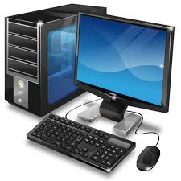
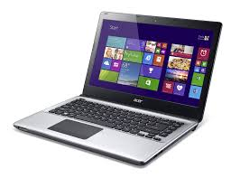
Types of Computer Systems
Desktops
General purpose computers
Variety of software
Designed for use by individuals
PCs, Notebooks
Computer Architecture, Spring 2020, AUT, Tehran, Iran

Slide 14
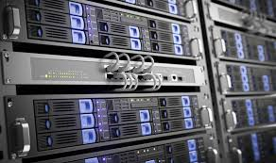
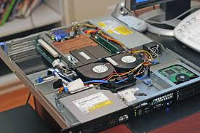
Types of Computer Systems
Servers
High-end computing systems
Consists of several CPUs
Used by multiple users
Networked based
High capacity, performance, reliability
Range from small servers to building sized
Computer Architecture, Spring 2020, AUT, Tehran, Iran

Slide 15
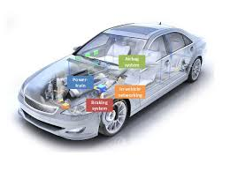
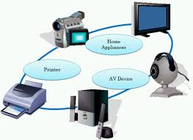
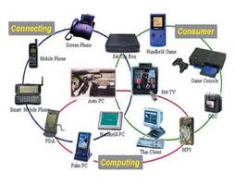
Types of Computer Systems
Embedded Systems
A computer system designed to perform one or a few dedicated functions
Often with real-time, power, high reliability, low-cost, size/weight constraints
Hidden as components of systems
Computer Architecture, Spring 2020, AUT, Tehran, Iran

Slide 16
Computer History
Mechanical Computers
Electro-Mechanical Computers
Electronic Computers
Computer Architecture, Spring 2020, AUT, Tehran, Iran

Slide 17
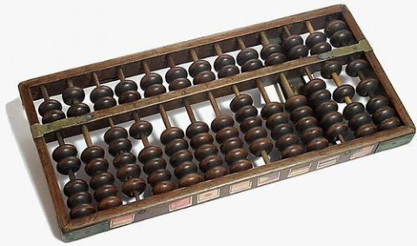
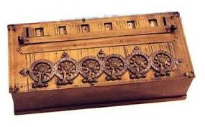
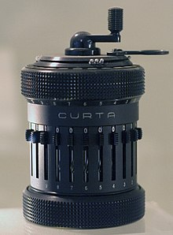
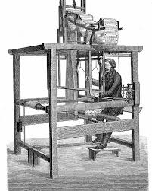
Computer History
Mechanical Computers
Abacus
Mechanical calculators
Pascal’s calculator (1642)
Curta (1930s)
Punched-card data processing (1725, 1800s, 1900s)
Computer Architecture, Spring 2020, AUT, Tehran, Iran

Slide 18
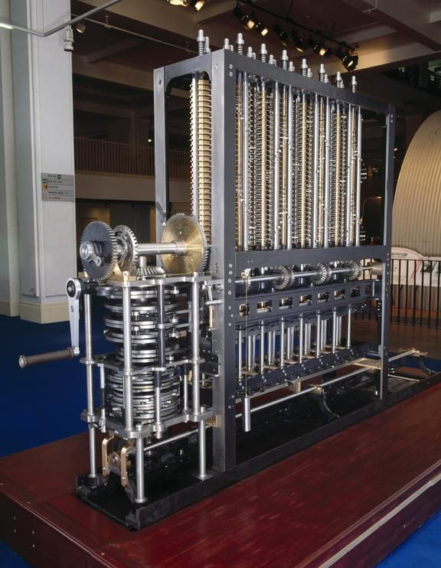
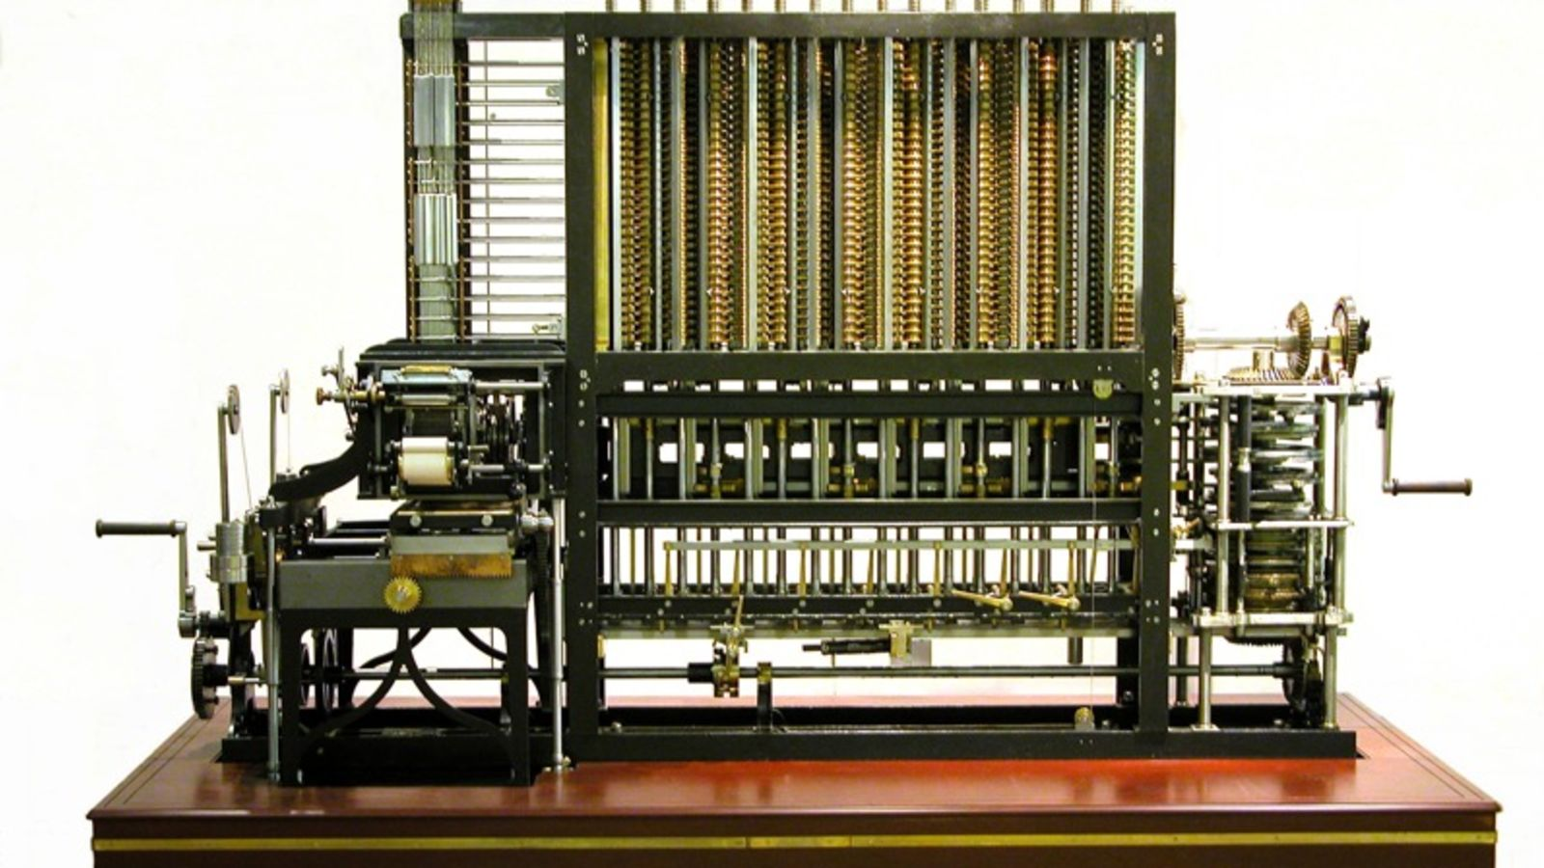
Computer History
Mechanical Computers
Difference engine: Charles Babbage (1791-1871)
First general-purpose computing device
Analytical engine
Computer Architecture, Spring 2020, AUT, Tehran, Iran

Slide 19
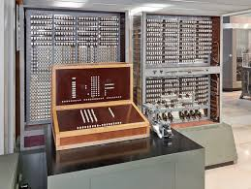
Computer History
Electro-Mechanical Computers
Switches, relays
Early 1900s
Zuse’s Z2, Z3, Z4 (world's first commercial digital computer, mechanical memory)
Computer Architecture, Spring 2020, AUT, Tehran, Iran

Slide 20
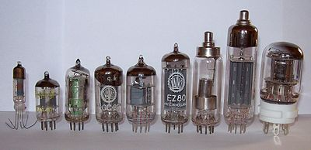
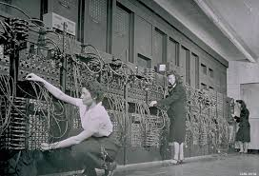
Computer History
Electronic Computers
1st generation
vacuum tubes (1945-1955)
ENIAC, 1946
Computer Architecture, Spring 2020, AUT, Tehran, Iran

Slide 21
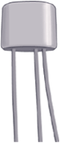
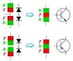
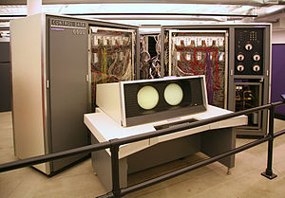
Computer History
Electronic Computers
2nd generation
BJT transistors (1955-1965)
CDC 6600 (1964-1969)
world's fastest computer from 1964 to 1969
$2,370,000
30kW, 6tons
10MHz, 2 MIPS
Up to 982 kilobytes
Computer Architecture, Spring 2020, AUT, Tehran, Iran

Slide 22
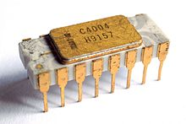
Computer History
Electronic Computers
3rd generation
integrated circuits (1965-1974)
Intel 4004 (1971)
The first commercially available microprocessor
10 µm process
92,000 instructions per second
1 MHz clock rate
Computer Architecture, Spring 2020, AUT, Tehran, Iran

Slide 23
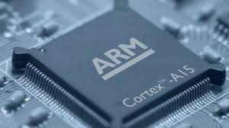
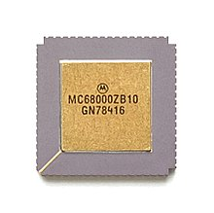
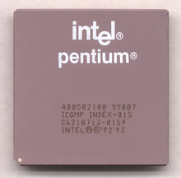
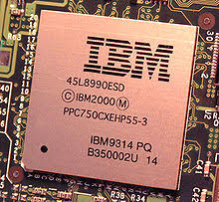
Computer History
Electronic Computers
4th generation: VLSI
1974-1989
5th generation: ULSI
1990-present
Computer Architecture, Spring 2020, AUT, Tehran, Iran

Slide 24
Computer History
Year | Technology Used in Computers | Relative Performance per unit cost
~1950 | Vacuum tube | 1
1960s | Transistor | 35
1975 | Integrated circuit | 900
1995 | Very large scale integrated circuit | 2,400,000
2005 | Ultra large scale integrated circuit | 6,200,000,000
Computer Architecture, Spring 2020, AUT, Tehran, Iran

Slide 25
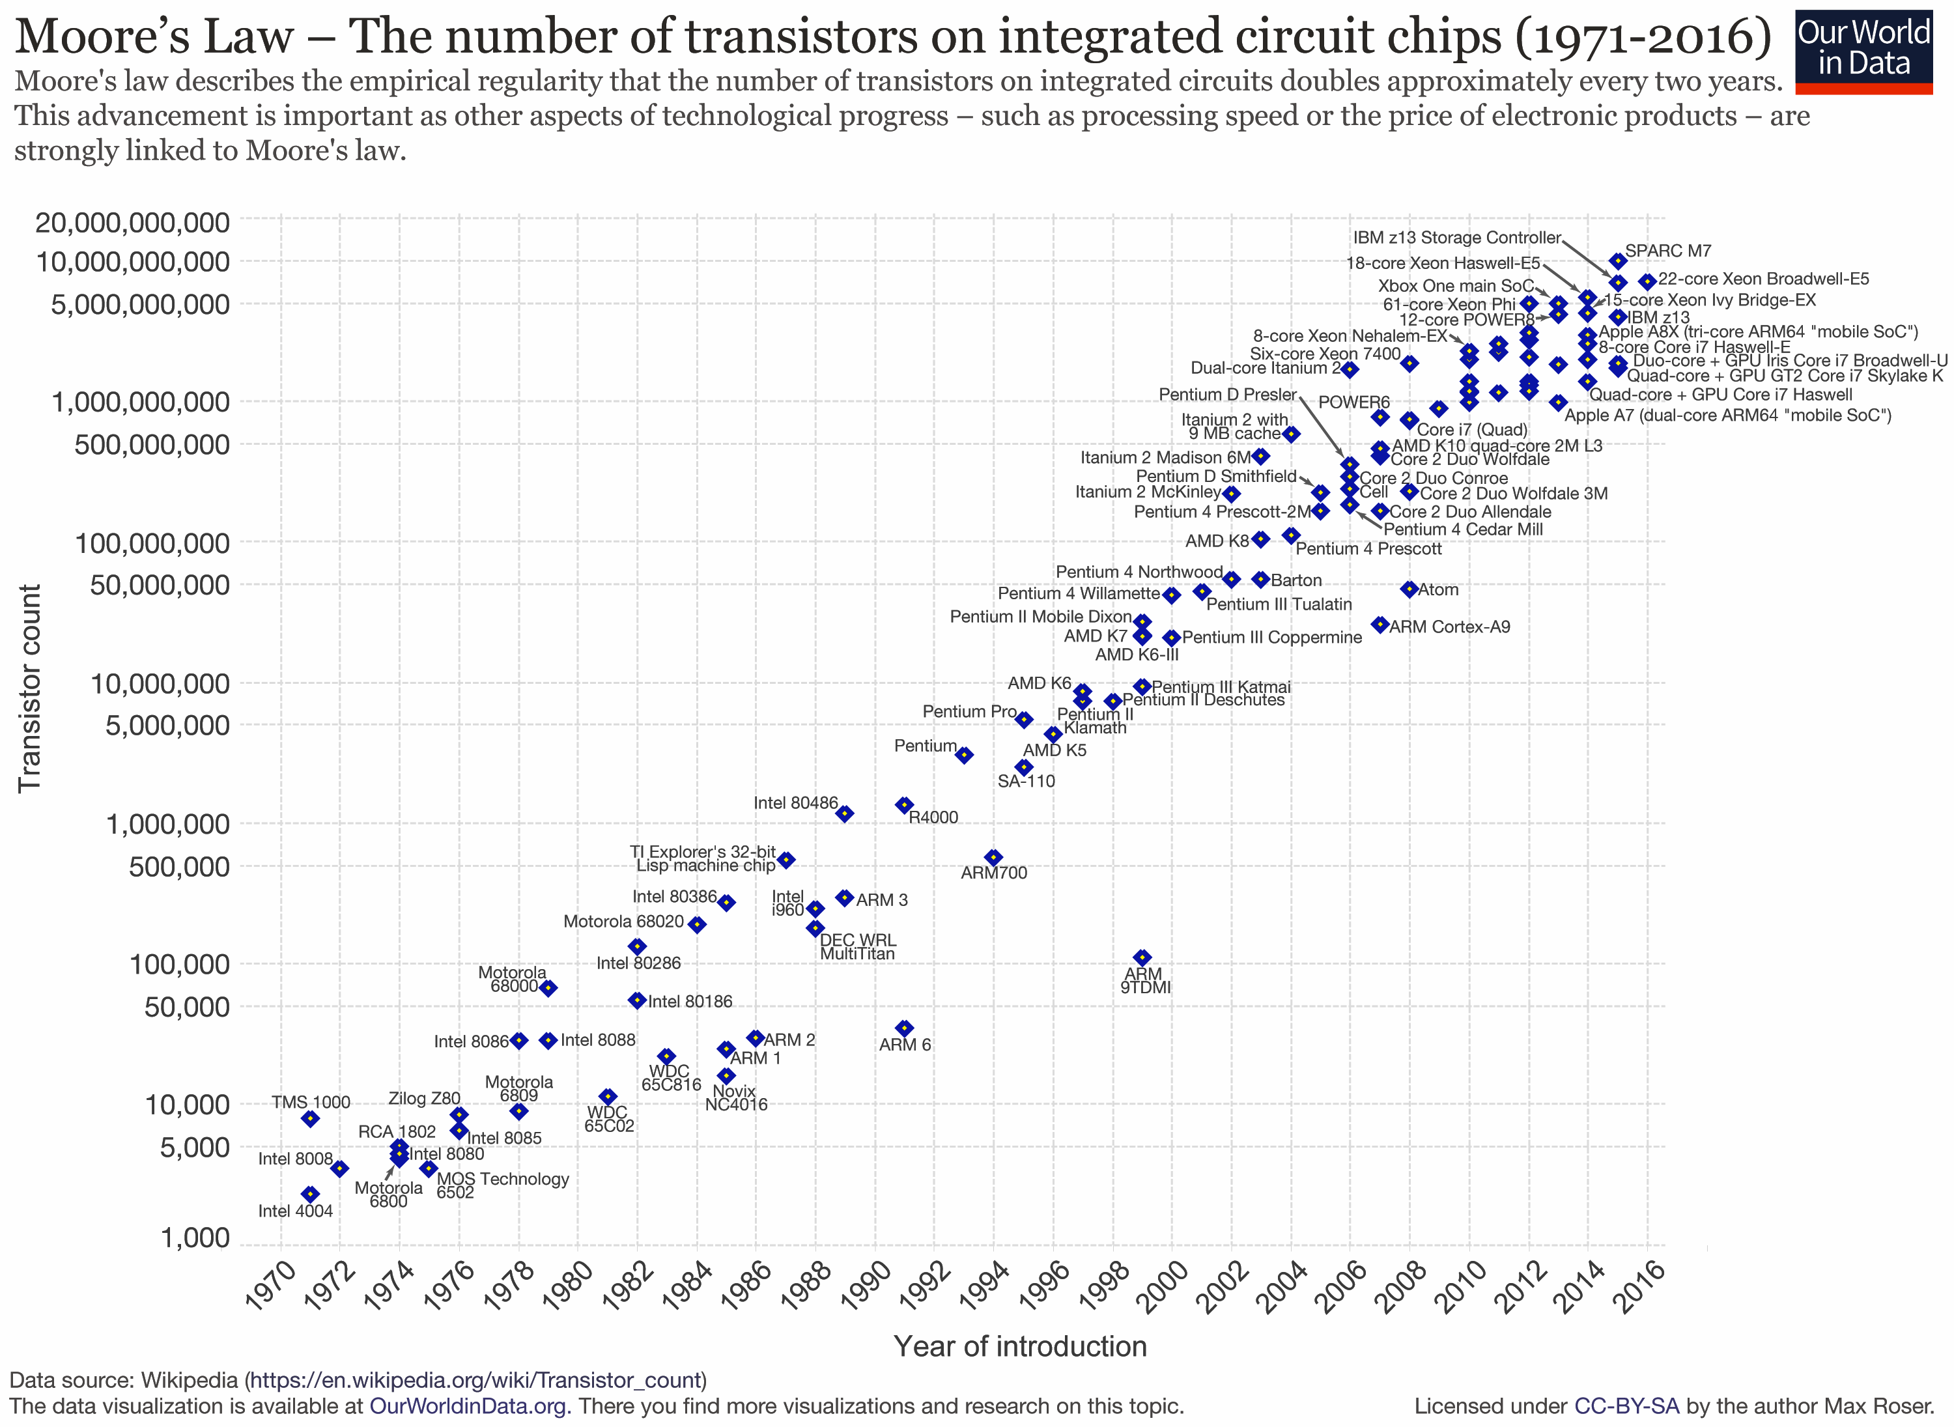
Computer History- Moore’s Law
What happened from 1970?
Transistor count doubles every 24-month
Computer Architecture, Spring 2020, AUT, Tehran, Iran

